Slide 1
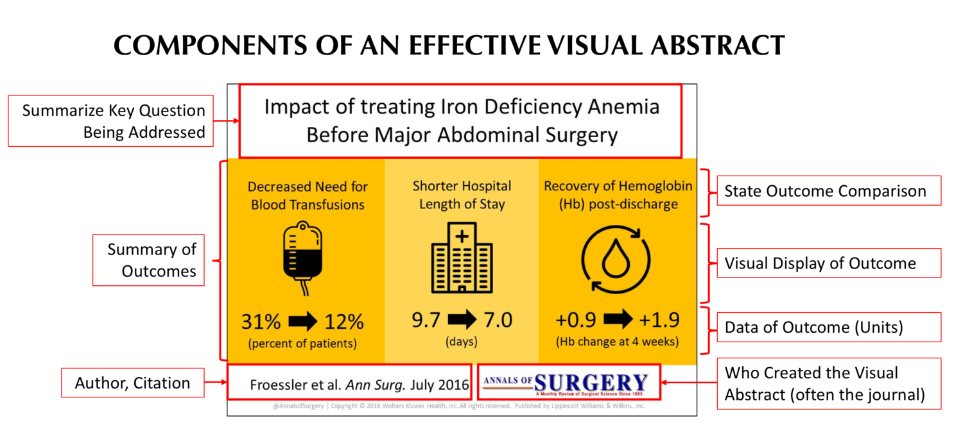
Template Provided By Genigraphics – 800.790.4001
Replace This Text With Your Title
REPLACE THIS BOX WITH YOUR ORGANIZATION’S
HIGH RESOLUTION LOGO
REPLACE THIS BOX WITH YOUR ORGANIZATION’S
HIGH RESOLUTION LOGO
John Smith, MD¹; Jane Doe, PhD²; Frederick Jones, MD, PhD^{1,2}
¹University of Affiliation, ²Medical Center of Affiliation
Place your visual abstract here.
Source: https://www.surgeryredesign.com/resources
TIP: If you are creating your visual abstract in PowerPoint, the default widescreen slide size fits perfectly in this space
Introduction
Results
Discussion
Click here to insert your Introduction text. Type it in or copy and paste from your Word document or other source
These text boxes will automatically re-size to your text. To turn off that feature, right click inside this box and go to Format Shape, Text Box, Autofit, and select the “Do Not Autofit” radio button.
Be sure to ZOOM out to 100% to preview how your images, fonts, and layout will look on your poster.
For tables, graphs, and charts, image quality is better if you do not paste them as a picture.
Be sure to check out our tips in the grey sidebars on changing the colors and layouts.
We also have how-to videos and tips on our website at www.Genigraphics.com
This text is Arial 36pt and is easily read up to 5 feet away on a 30x44 poster.
To change the font style of this text box: Click on the border once to highlight the entire text box, then select a different font or font size that suits you.
Methods and Materials
This text is Arial 32pt and is easily read up to 5 feet away. To change the font style of this text box: Click on the border once to highlight the entire text box, then select a different font or font size
 | Heading | Heading | Heading
Item | 800 | 790 | 4001
Item | 356 | 856 | 290
Item | 228 | 134 | 238
Item | 954 | 875 | 976
Item | 324 | 325 | 301
Total | 199 | 137 | 186
Conclusions
This text box will automatically re-size to your text. To turn off that feature, right click inside this box and go to Format Shape, Text Box, Autofit, and select the “Do Not Autofit” button.
Table 1. Label in 28pt Arial.
Figure 1. Label in 28pt Arial.
Contact
References
[name]
[organization]
[address]
[email]
[phone]

