Slide 1

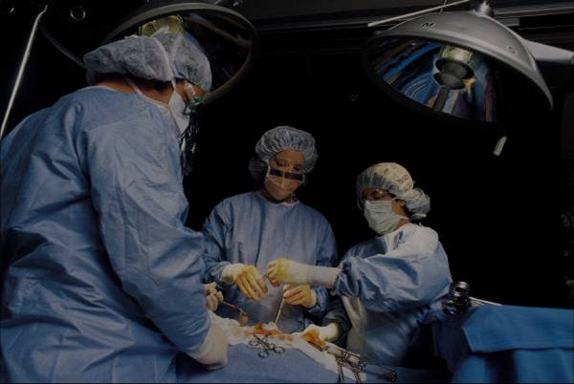
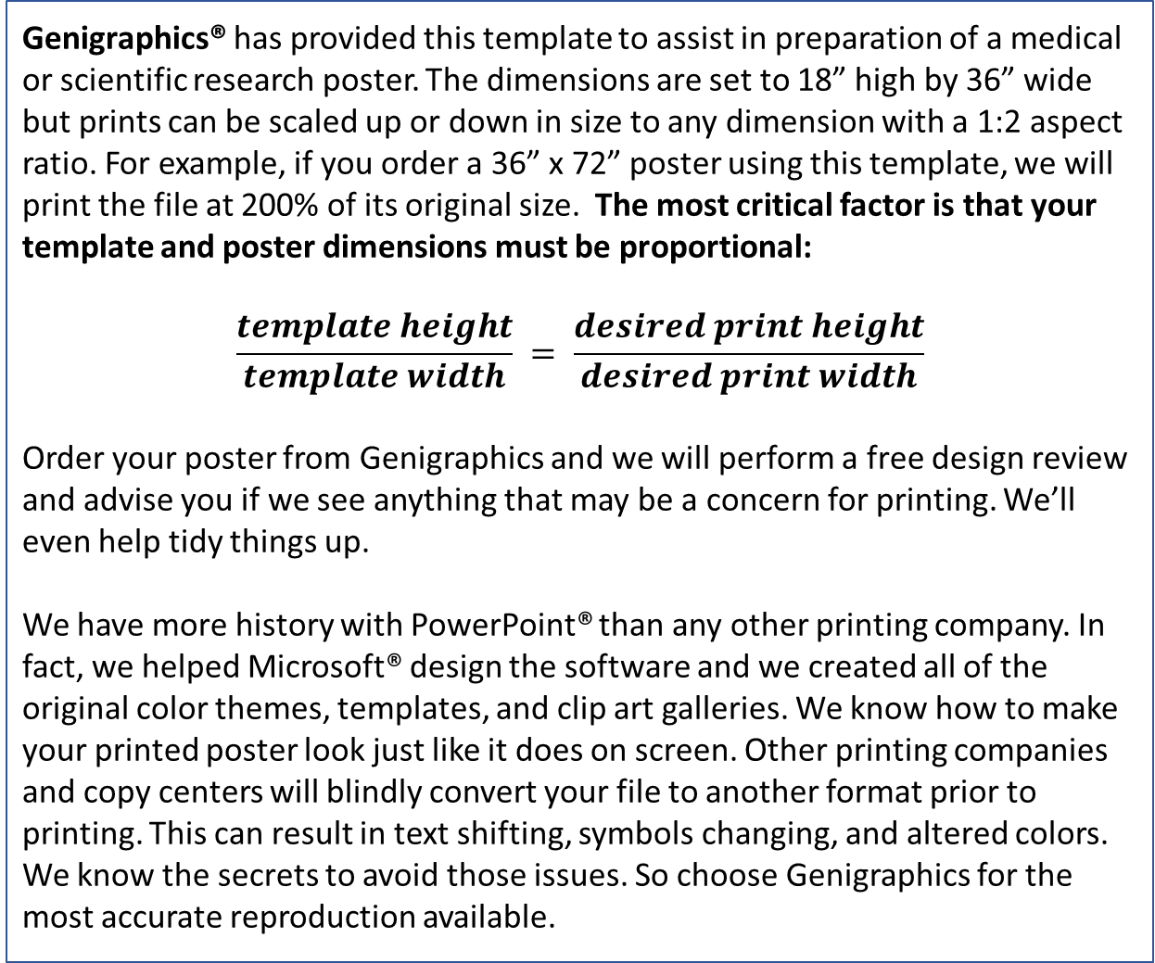
Template Provided By Genigraphics – 800.790.4001 – Replace This Text With Your Title
LOGO
San Antonio Breast Cancer Symposium
December 10-13, 2024
John Smith, MD¹; Jane Doe, PhD²; Frederick Jones, MD, PhD^{1,2}
¹University of Affiliation, ²Medical Center of Affiliation
Abstract
Methods and Materials
Results
Discussion
Click here to insert your Abstract text. Type it in or copy and paste from your Word document or other source.
This text box will automatically re-size to your text. To turn off that feature, right click inside this box and go to Format Shape, Text Box, Autofit, and select the “Do Not Autofit” radio button.
To change the font style of this text box: Click on the border once to highlight the entire text box, then select a different font or font size that suits you. This text is Calibri 18pt and is easily read up to 4 feet away on a 18x36 poster and up to 8 feet away on a 36x72 poster.
Zoom out to 100% (for 18x36) or 200% (for 36x72) to preview what this will look like on your printed poster.
Click here to insert your Methods and Materials text.
Click here to insert your Results text.
Click here to insert your Discussion text.
Introduction
Genigraphics® has provided this template to assist in preparation of a medical or scientific research poster. The dimensions are set to 18” high by 36” wide but prints can be scaled up or down in size to any dimension with a 1:2 aspect ratio. For example, if you order a 36” x 72” poster using this template, we will print the file at 200% of its original size. The most critical factor is that your template and poster dimensions must be proportional:
$$\frac{template height}{template width} = \frac{desired print height}{desired print width}$$
Order your poster from Genigraphics and we will perform a free design review and advise you if we see anything that may be a concern for printing. We’ll even help tidy things up.
We have more history with PowerPoint® than any other printing company. In fact, we helped Microsoft® design the software and we created all of the original color themes, templates, and clip art galleries. We know how to make your printed poster look just like it does on screen. Other printing companies and copy centers will blindly convert your file to another format prior to printing. This can result in text shifting, symbols changing, and altered colors. We know the secrets to avoid those issues. So choose Genigraphics for the most accurate reproduction available.
Figure 1. Label in 20pt Calibri.
Figure 2. Label in 20pt Calibri.
Conclusions
Table 1. Label in 20pt Calibri.
Chart 1. Label in 20pt Calibri.
Click here to insert your Conclusions text.
 | Heading | Heading | Heading
Item | 800 | 790 | 4001
Item | 356 | 856 | 290
Item | 228 | 134 | 238
Item | 954 | 875 | 976
Item | 324 | 325 | 301
Item | 199 | 137 | 186
Click here to insert more Results text.
Contact
References
<your name>
<your organization>
Email:
Website:
Phone:
This presentation is the intellectual property of the author/presenter. Contact them at <<your email address>> for permission to reprint and/or distribute.

